Slide 1
GUIDLINE OF MANAGEMENT OF PROSTATE CANCER
Dr Magezi Moses
MBchB,Mmed surgery, FCSUro.
HOD Surgery St. Francis Hospital Nsambya

Slide 2
INTRODUCTION
Sex accessory tissues include the prostate, seminal vesicles, ampullary glands, and bulbourethral glands,
And they are believed to play a major but unknown role in the reproductive process.
The prostate forms acini and collecting ducts by arborization into the urethra;
The growth occurs primarily on the tips, as the ducts extend and branch during development. ( Sugimura et al, 1986 ; Banerjee et al, 1993a, 1993b; Cunha, 1994 ).

Slide 3
CONT.
The prostate, like other sex accessory tissues, is stimulated in its growth, maintenance, and secretory function by the continued presence of certain hormones and growth factors.
Foremost among these is testosterone, which is converted within the prostate into the more active androgen dihydrotestosterone (DHT).

Slide 4
CONT.
Testosterone is synthesized in the Leydig cells of the testes from pregnenolone by a series of reversible reactions.
However, once testosterone is converted by 5α-reductase into DHT or converted by aromatase into estrogens, the process is irreversible;
testosterone can be converted to DHT or estrogens, but estrogens and DHT cannot be converted to testosterone

Slide 5
BPH
Previously held notions that the clinical symptoms of BPH (prostatism) are due simply to a mass-related increase in urethral resistance are too simplistic.
It is now clear that a significant portion of LUTS is due to age-related detrusor dysfunction.
The nomenclature of voiding dysfunction in aging men is confusing and often inaccurate ( Thomas and Abrams, 2000 ).

Slide 6
SERUM BIOMARKERS FOR PROSTATE CANCER
Since its discovery in 1979 to clinical application in the late 1980s through 1990s,
prostate-specific antigen (PSA) has evolved into an invaluable tool for the detection, staging, and monitoring of men diagnosed with prostate cancer ( Sensabaugh et al, 1978 ; Wang et al, 1979, 1981 [243] [242]; Papsidero et al, 1980 ; Kuriyama et al, 1981 ).
Whereas the majority of prostate cancers in the 1980s and early 1990s commonly arose with an abnormal digital rectal examination (DRE) or elevated PSA, or both, today most prostate cancer arises as clinically nonpalpable (stage T1c) disease with PSA between 2.5 and 10 ng/mL.
The evolving demographics and natural history of prostate cancer have resulted in a stage migration to nonpalpable, clinically localized (stage T1c) disease and a parallel reduction in mortality (Pound et al, 1997, 1999 [188] [187]; Stephenson et al, 1997 ; Polascik et al, 1999 ).

Slide 7
Cont.
Unfortunately, there is an overlap in the serum PSA levels among men with cancer and those with benign disease.
Thus, elevated serum PSA levels may reflect alterations within the prostate secondary to tissue architectural changes such as cancer, inflammation, or benign prostatic hyperplasia (BPH).
Although up to 30% of men presenting with an elevated PSA may be diagnosed following this invasive procedure, as many as 75% to 80% are not found to have cancer.

Slide 8
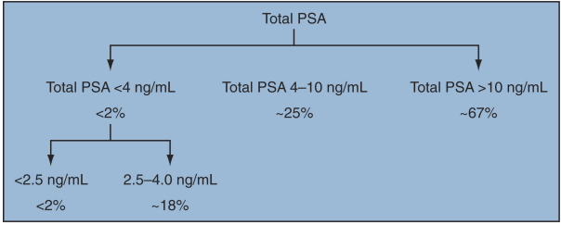
Cont.

Slide 9
Cont.
The histologic diagnosis of prostate cancer is made, in the majority of cases, by prostate needle biopsy.
Prostate cancer rarely causes symptoms until it is advanced.
Thus, suspicion of prostate cancer resulting in a recommendation for pros-tatic biopsy is most often raised by abnormalities found on digital rectal examination (DRE) or by serum prostate-specific antigen (PSA) elevations.
Although there is controversy regarding the benefits of early diagnosis, it has been demonstrated that an early diagnosis of prostate cancer is best achieved using a combination of DRE and PSA.

Slide 10
STAGING OF PROSTATE CANCER
Clinical staging of prostate cancer aims to utilize pretreatment parameters to predict the true extent of disease.
The goals of cancer staging are to allow the assessment of prognosis and facilitate educated decision-making regarding available treatment options.
An accurate assessment of disease extent is critical for men with newly diagnosed prostate cancer because pathologic stage is the most reliable means of predicting the outcome of definitive treatment in men with clinically localized cancer ( Pound et al, 1997 ).

Slide 11
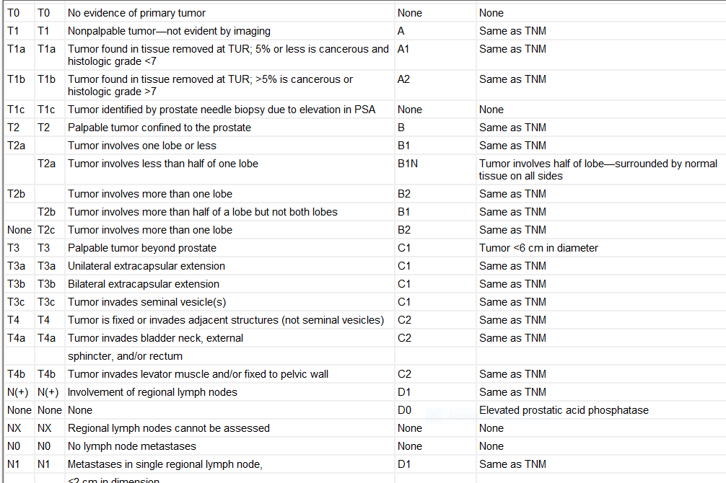

Slide 12
TREATMENT.
Active monitoring and watchful waiting are almost unique to prostate cancer. There are different concepts of deferred treatment of prostate cancer.
Watchful waiting is monitoring the patient until he develops metastatic disease that requires palliative treatment.
Active monitoring allows delayed primary treatment if there is evidence of cancer progression.
Currently, treatment is frequently initiated because of the patient's anxiety from living with untreated cancer combined with a rising PSA level or biopsy findings that suggest an increase in the volume or Gleason grade of the cancer.

Slide 13
Cont.
Radical prostatectomy was the first treatment used for prostate cancer and has been performed for more than 100 years ( Kuchler, 1866 ; Young, 1905 ).
It is a technically formidable operation, and as a result, simpler treatments have been sought for the treatment of early-stage disease.
However, no treatment has supplanted radical prostatectomy, and it still remains the “gold standard” because of the realization that hormone therapy and chemotherapy are never curative,
And not all cancer cells can be eradicated consistently by radiation or other physical forms of energy, even if the tumor is contained within the prostate gland.

Slide 14
Metastatic Hormone-Refractory Disease Hormone Therapy
Patients with metastatic hormone-refractory prostate cancer represent a heterogeneous group with respect to their clinical status at the time of disease progression
Metastatic adenocarcinoma of the prostate has an overwhelming predilection to involve primarily bone

Slide 15
.
END
THANKS

