Slide 1
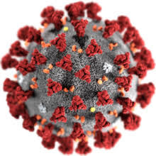
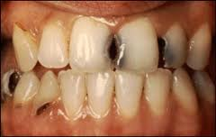
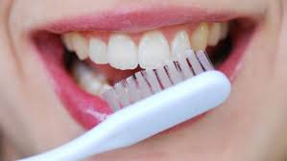
COVID-19 PANDEMIC & COMMON DENTAL CHALLENGES
MULUYA KHARIM MWEBAZA (PhD)
Asst. District Health Officer (Env’tal Health) – Iganga
muluyak@gmail.com
+256 772 820 565/704 887 896

Slide 2
COVID-19 AND DENTAL PRACTICE (Kalenderian et al., 2022)
COVID-19 virus is profusely present in nasopharyngeal and salivary secretions of patients.
Its spread primarily through respiratory droplets, as well as aerosols and fomites.
Importantly, emerging evidence shows that normal breathing and talking can produce small droplets that are subject to aerosol transport and some viral particles can remain suspended in the air for several hours.
Some dental procedures may lead to aerosol generation.

Slide 3
COVID-19 AND DENTAL PRACTICE
Approx. 198,000 dentists shut down clinics due to COVID-19 in the USA (Kalenderian et al., 2022).
Majority of dentists knew dental clinics were source of infections.
About 70% of dentists did not perform non-emergency procedures during the pandemic (Ahmadi, Ebrahimi & Ghorbani, 2020).
They suggested several strategies to decrease the risk of contagion. For example;
Reducing treatment sessions.
Strict triage of patients.
Use of personal protective equipment (but prizes were high).
However, many dentists reduced income.

Slide 4
CURRENT SITUATION (In ref. to 3rd wave)
Iganga District (Source: DHO’s Office)
*Cumulative alerts: 2,580
*Cumulative tests: 2,203
*Cumulative positives: 617
*Cumulative HBC: 596
*Cumulative Recoveries: 590
*Cumulative admissions: 18
*Cumulative Deaths: 13
*Current Admission: 00
*Health Workers infected: 33
(No Dentist – most of them are nurses, midwives, support staff & admins.).

Slide 5
CURRENT SITUATION What is the situation there?
Are people still observing the SOPs ? (HCs & Public).
Provision of the PPEs (esp. for HWs).
Are people embracing the vaccination exercise?
(R1 & R2 vaccination, routine immunization, who is eligible?, single dose vs. double dose etc.).
Remuneration of HWs (also VHTs & LCIs).
Do we still receive messages/information concerning COVID-19?

Slide 6
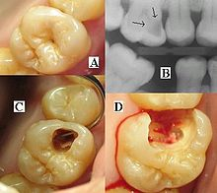
DEFINITION(S)
WHAT IS DENTAL HEALTH?
At times referred to as oral health is defined as “the absence of disease and the optimal functioning of the mouth and its tissues, in manner that preserves the highest level of self-esteem.”
Oral diseases and conditions are an important public health concerns because of their high prevalence, their severity, or public demand for services because of their impact on individuals and society.

Slide 7
DENTAL CHALLENGES EXPERIENCED DURING THE COVID-19 PANDEMIC
Common dental conditions
Dental caries (commonly termed as dental decay).
Dependent on 4 elements/factors; sugar, time, bacteria & tooth.
Pulpitis (acute or chronic).
Tooth sensitivity.
(Extraction, restorative & endodontic treatments).
Gingivitis (exhibits symptoms of bleeding, swelling and pain).
Attributed to poor oral hygiene (accumulation of plaque) & trauma.
Scaling, change of brushes, motion of brushes when brushing, drugs)

Slide 8
DENTAL CHALLENGES EXPERIENCED DURING THE COVID-19 PANDEMIC Common dental conditions cont..
Periodontal disease (it’s suppression of gingivitis).
Destruction of the ligaments & alveolar bone.
Increase the risk of stroke, heart attack and others.
Its management (like for gingivitis)
Accidents (dental fractures).
GBV, runs with security, overloading etc.)
Dental wiring & drugs.
Cosmetics
Prosthodontics (deals with replacement of missing teeth).
It can be crowns, bridges or dentures (fixed or removable).
Dental braces

Slide 9
WHAT IS SO UNIQUE WITH DENTAL PRACTIONERS EVEN BEFORE COVID-19?
It’s a practice for dentists (protect themselves & patients).
Hand washing every after a patient.
Change of gloves every after a patient.
Wearing masks.
Wearing of gowns.
Use of goggles (face shields).

Slide 10
HOW TO AVOID FREQUENT VISITS TO A DENTIST IN THE ERA OF COVID-19?
Brushing at least twice a day with fluoridated tooth paste.
Rinsing / gargling.
Planned checkups.
Fluoridation
Periodic scaling.
Eat nutritious foods and balanced meals.

Slide 11
CONCLUSION
Patients with dental conditions are unable to go about their work normally due to pain associated with the ailment.
Since dental conditions affect many people with different responsibilities, its believed that it equally affects the labour force of society which substantially affects numerous economic activities.
Therefore, if dental cases are reduced, it can contribute to proper/complete mastication of food materials that increase the immunity of the patients and also maintain their beauty.

Slide 12
THANK YOU

